Slide 1

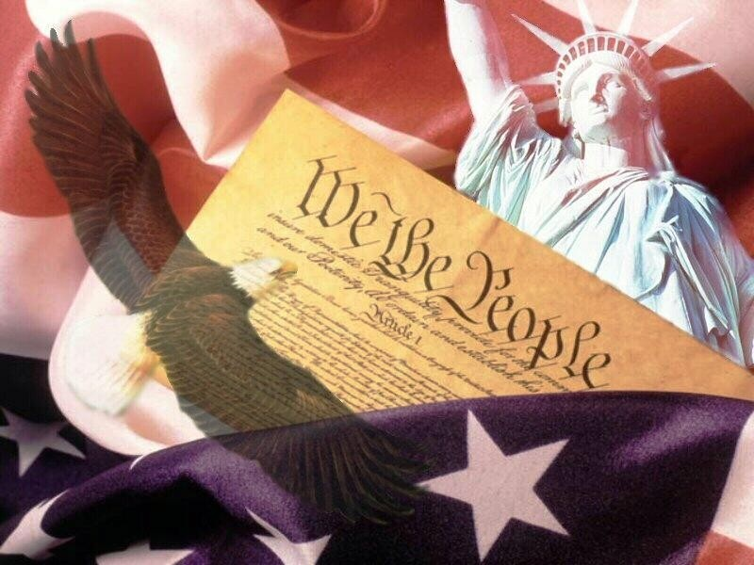
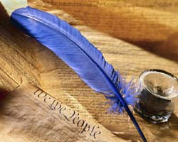
(American flag, 2008)
The Foundation and Elements
of the
United States Constitution
(Constitution and Quill, 2008)
(Constitution, 2008)
By Patricia Saluta
March 13, 2008
AP American Government

Slide 2
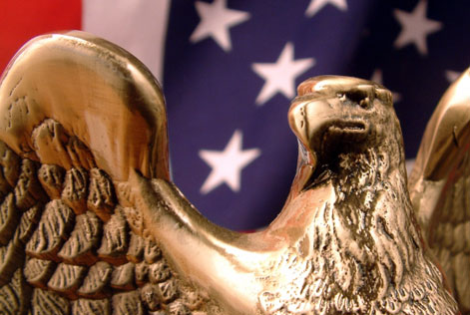

Introduction
The supreme law of the land in our country is known to be the Constitution of the United States. (Crihfield, 2008) However, this document did not come into formation with ease. This new government arose from previous failed attempts and constant struggles between sides. (Crihfield, 2008) With discussions and compromises, this document, according to Magruder (2004), contains the foundation for our nations’ government and exemplifies the rights of the citizens. For over 200 years, this powerful document has remained virtually untouched with only a handful of adjustments. (Wikipedia, 2008)
(Government, 2008)

Slide 3
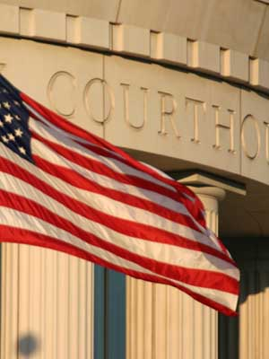
The Foundation
of the Constitution
(Government, 2008)

Slide 4

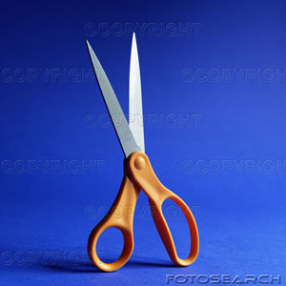
Declaration of Independence
I selected the photos of scissors to represent the Declaration of Independence because the United States had suppressed ties with England and declared themselves to be independent. (Magruder, 2004) The scissors symbolizes the act of the States; cutting all ties from England and becoming a free nation. I also added a quote directly from the constitution because it captures the meaning of the historic document.
(Scissors ribbon, 2008)
In 1776, the Declaration of Independence was the work of five prominent men – Benjamin Franklin, John Adams, Roger Sherman, Robert Livingston, and Thomas Jefferson. (Magruder, 2004) According to Dr. Crihfield (2008) ,this proclamation of independence, mostly written by Jefferson, stated the nation as independent from England and declared itself as a nation of its own. The body of the document consisted of a declaration to be a new country and the all the wrong doings of England upon the Colonies. (Magruder, 2004) Many of the injuries included the acts passed by King George III. (Wikipedia, 2008) These acts included the Quartering Acts, Navigation Acts, and the Stamp Act. (Crihfield, 2008)
“That these United Colonies are, and of right ought to be, free and independent States…and that all political connection between them…be, totally dissolved.”
-The Declaration of Independence (1776)
(Scissors, 2008)

Slide 5

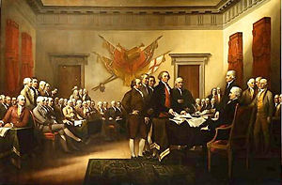
The Second Continental Congress
The picture of the different shapes was selected to represent the Second Continental Congress because it depicts the different kinds of people that attended. Those who came to the meeting were comprised of a mixed group of people with different backgrounds and views on their government. (Crihfield, 2008) This allowed for a diverse range of topics to discuss and decisions to made about their States. The picture shows the different varieties of shapes and their array of colors, no two are alike. The image on the right is a portrait of the Second Continental Congress in session.
(Different Shapes, 2008)
(Second Continental Congress, 2007)
The Second Continental Congress came into action when it was called during the First Continental Congress in 1774. (Magruder, 2004) Furthermore, the purpose of this second meeting was to discuss a plan for the confederation of the states. (Magruder, 2004) Those in attendance to the meeting were people of different backgrounds and outlooks. (Crihfield, 2008) Congregating in May 1775, the Revolutionary War was taking place and talks prolonged for over a year. (Wikipedia, 2008) Within the committee of 50 members, they voted for independence and adopted the Declaration of Independence in 1776. (Encarta, 2007) After 17 months, the Articles of Confederation was created by the congress as their the new country’s form of government. (Magruder, 2004)

Slide 6
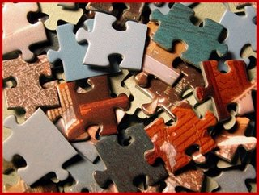
The Articles of
Confederation
I chose this image to represent the Articles of Confederation because it depicts the underlying effect of this form of government. According to Dr. Crihfield (2008), the Articles of Confederation was merely a loose association of states. The puzzle pieces are similar to the states. The puzzle pieces are separate when not making an image and are useless when not together. Under this document, the states were not working as one body and therefore, it faced many problems that led to amending it. (Crihfield, 2008)
(Pile Puzzle Pieces, 2008)
The Articles of Confederation was designed by the Second Continental Congress in 1777 and placed into effect by 1778. (Wilson & Diluilo, Jr., 2004) There was now a unicameral congress that had the ability to make treaties, borrow money, raise an army using state troops, and make war and peace. (Magruder, 2004) This new government still allowed each of the states to keep its sovereignty and independence, which seemed reasonable at the time. (Wilson & Diluilo, Jr., 2004) However, important factors were missing such as a national army, required collection of taxes, and power to regulate trade between states. (Magruder, 2004) Therefore, problems occurred within the country dealing with power; treaties couldn’t be signed, there was no trade, British remained in forts on U.S. soil, and Shay’s Rebellion occurred. (Crihfield, 2008) The Articles of Confederation were later ratified due to its weakness in 1787. (Magruder, 2008)

Slide 7
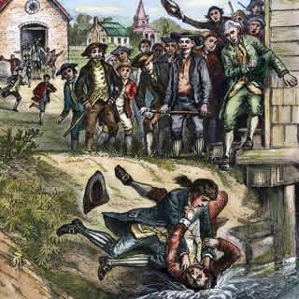
Shay's Rebellion
Shay’s Rebellion occurred in 1787 when Daniel Shay, along with soldiers and officers of the war, became concerned with his high taxes and loss of land to the government. (Wilson & Diluilo, Jr., 2004) As a group, they gathered in front of their courts in western Massachusetts and prevented the members from sitting. (Wilson & Diluilo, Jr., 2004) With Shay and his group armed with arsenals, this prompted the courts to shutdown and the governor called for troops. (Magruder, 2004) However, the state of Massachusetts did not have a state army and relied on a volunteer army which took time to form. (Wilson & Diluilo, Jr., 2004) Without a national army, many lives were in danger when things could not be in control. (Wilson & Diluilo, Jr., 2004) This occurrence showed the true weakness within the Articles of Confederation. (Crihfield, 2008)
This image was used to represent Shay’s Rebellion because it showcases a scene straight out of the action that occurred that moment. In 1787, Daniel Shay and other officers and soldiers of the Revolutionary War stood up against the courts in a Massachusetts town, enabling them to sit. (Wilson & Diluilo, Jr., 2004) This caused a major movement and was later a defying factor to the amending of the Articles of Confederation. (Crihfield, 2008)
(Shay’s Rebellion, 2008)

Slide 8
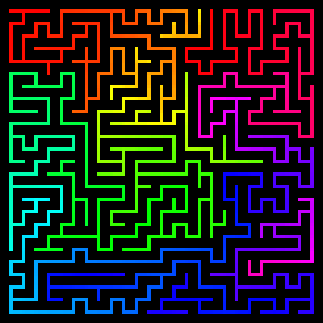
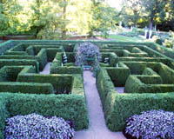
Constitutional Convention
The two images of mazes were used to represent the Constitutional Congress because the members kept the meeting a secret. (Crihfield, 2008) They would take alternative paths going to and from the meeting so nobody would be question their actions. (Crihfield, 2008) Their behavior is very similar to that of a maze. A maze has various paths, but all lead to the same spot at the end.
(Maze, 2008)
(Maze, 2008)
The Constitutional Convention, a meeting held to discuss the current government, was held in May of 1787 in Philadelphia. (Magruder, 2008) Out of seventy-nine delegates called, fifty-five attend and thirty-nine remained for the entire convention. (Crihfield, 2008) This group had the make up of white, male, educated, Christian, and conservative and therefore, built a government that reflected them. (Crihfield, 2008) Their first order of duty was to amend the Article of Confederation. (Crihfield, 2008) Proceeding, they spent one month studying past forms of governments to have a better understanding on what form would suit the country. (Crihfield, 2008) After much discussion, the convention came with a new form of government that held ideals such as a majoritarian democracy, federalism, republic, and checks and balances. (Crihfield, 2008) This new government was placed into a document titled the Constitution. (Crihfield, 2008)

Slide 9
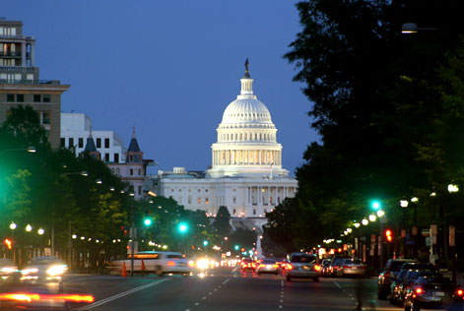
The Elements
of the Constitution
(Washington D.C., 2008)

Slide 10

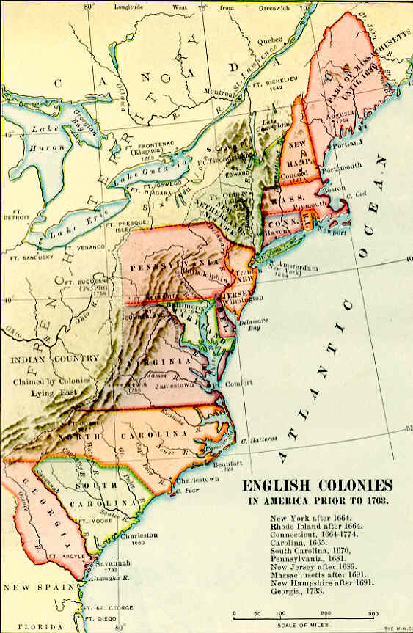
The Great Compromise
These images were selected to depict the Great Compromise because of their content. The map of the colonies represents the location and size of Virginia and New Jersey. Smaller states, such as New Jersey, feared that they would not gain a voice in the new government because of the representation of larger states, such as Virginia. (Magruder, 2004) The second image of the handshake, represents the compromise between Virginia and New Jersey and forming a new idea by using elements from both proposals. (Wilson & Diluilo Jr., 2004)
(Handshake, 2008)
During the Constitutional Convention, there was a major concern over the plan of the new government. (Wilson & Diluilo, Jr., 2004) The prominent state of Virginia suggested a three branch government which included the legislative, executive, and judicial. (Magruder, 2004) The legislative would then have two houses: the Senate and the House of Representatives. (Magruder, 2004) Futhermore, the representations in the houses was to be determined on each of the state’s populations or on the amount of money the state give to support the government. (Magruder, 2004) New Jersey, on the other hand, had a plan to continue the one house Congress that was used under the Articles of Confederation. (Magruder, 2004) The argument about the representation in Congress became a major discussion during the convention because large states wanted to be dominate in the government while small states felt that the wouldn’t be protected under the law. (Magruder, 2004) With time, a compromise was reached between the two. The new government was to have a congress of two houses. (Magruder, 2004) The Senate would have the representation of states equally, while the House of Representatives would have representation based on the states population. (Magruder, 2004) All conflict was solved with the Great Compromise (Magruder, 2004)
(Colonies, 2008)

Slide 11


Checks and Balances
The images of the closets were chosen to represent the idea of checks and balances in the Constitution. Like the pictured closets, the system was created to maintain separation of powers and organization within the government through having each branch watch over another. (Crihfield, 2008) The organized closets represent this it keeps things separate and organized. Shirts are in one part of the closet away from the shoes.
(Closets, 2008)
An element of the Constitution is the idea of checks and balances. (Wilson & Diluilo, Jr., 2004) Checks and balances were created to maintain a separation of powers between the branches and to supervise one another to ensure that a branch does not become too powerful. (Crihfield, 2008) The ideal of checks and balances came from James Madison’s belief that each branch should remain separate with its own specific powers. (Wilson & Diluilo, Jr., 2004) Examples of checks and balances are that the president can check congress by placing a veto a bill and congress can check the president by overriding the veto with a two-thirds vote. (Wilson & Diluilo, Jr., 2004) The president can check the courts by appointing judges and the courts can check congress by stating a law is unconstitutional. (Wilson & Diluilo, Jr., 2004)
(Closets, 2008)

Slide 12


Slavery
(Crumpled Paper, 2008)
(Trash can, 2008)
These images of crumpled paper and a trash can depict the statements of slavery in the Constitution. Slavery was a discussion within the Constitutional Convention and if they were to be part of the law. (Wilson & Diluilo, Jr., 2004) Although the topic of slavery is mentioned within the document, its resolution was not. (Wilson & Diluilo, Jr., 2004) The situation is similar to a crumpled paper. It signifies an idea that didn’t work out and is left to be fixed later on or to be lost of completely and thrown away.
The topic of slavery was only taken to an extent when discussed in the Constitution. (Wilson & Diluilo, Jr., 2004) However, the word “slavery” was not used, but rather replaced with the phrases “other persons,” “persons of labour,” and “persons held to service or labour.” (Wilson & Diluilo, Jr., 2004) Within the Constitution, only three provisions were made slave trade and owning. (Wilson & Diluilo, Jr., 2004) The Three-Fifths Compromise explained that a slave would be counted for three-fifths a person in regard to the states’ population and for the purposes of taxation. (Wilson & Diluilo, Jr., 2004) Another statement about slavery was that Congress could not prohibit the importation of slaves until the year 1808. (Wilson & Diluilo, Jr., 2004) The Constitution also stated that if a slave were to escape a state-owning state and flee to a free state, the slave was not counted as a free person but, were to be returned to their master. (Wilson & Diluilo, Jr., 2004) These mere changes did not do anything to ease the problem of slavery, but worsened it instead. (Wilson & Diluilo, Jr., 2004) In the following years, the problem would rise again in the Civil War. (Wilson & Diluilo, Jr., 2004)

Slide 13
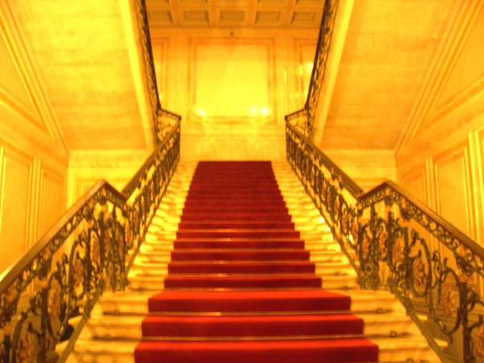
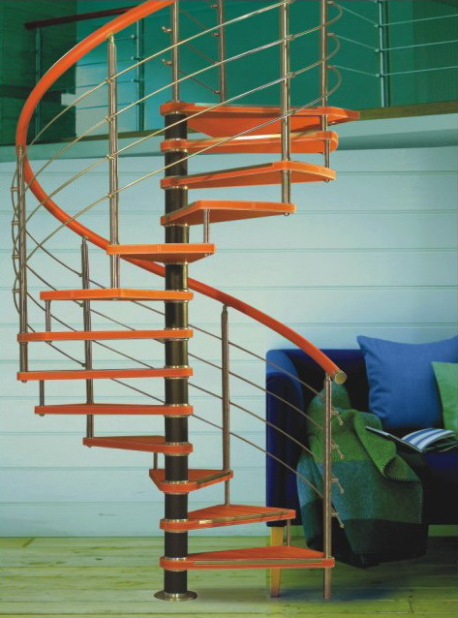
Federalism
The image of the staircase was used to depict this element of the Constitution because the concept of federalism is when power is shared between the central government and the local governments. (Crihfield, 2008) The staircase is similar to the idea of federalism in a way that the different types of government are like the steps. The bottom step would be the local governments, which would then lead to the state governments. The top step would then be the national government which is above all the other governments.
(Staircase, 2008)
According to Magruder (2004), the concept of Federalism is defined as the sharing of powers among a central government and several other regional governments. Those in attendance of the Constitutional Congress felt a need for a government that still maintained the states and their local governments. (Magruder, 2004) The idea of federalism was a reasonable answer to the problem because states still had their own power, but were linked to a national government. (Magruder, 2004) With this, a major problem of the Articles of Confederation was solved because it tied states together and were no longer a loose association. (Crihfield, 2008)
(Staircase, 2008)

Slide 14
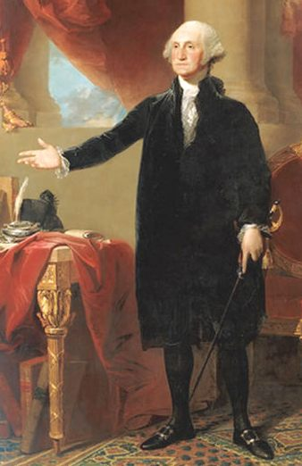
Presidents
The portrait of President George Washington was chosen to depict the theme of presidents because he is well known for becoming the nation’s first president. (Crihfield, 2008) His name is well recognized as being the first leader, despite his lack of intellectual thoughts. (Crihfield, 2008) Furthermore, President Washington was a strong working man and was chosen because of his strength and courage displayed throughout past history. (Crihfield, 2008)
In the Constitution, a major new part of the government was the formation of a leader. (Magruder, 2008) During the Articles of Confederation, no leader was stated because of the fear they had from England and their king. (Crihfield, 2008) When a new government was created, a leader had to be set to represent the country in foreign affairs. (Crihfield, 2008) The qualifications of a President was stated in the Constitution and included the minimum age of thirty-five years old, a natural born citizen, and a resident of the United States for fourteen years. (Wilson & Diluilo, Jr., 2004) The president also held special powers such as the Commander in Chief of the armed forces, the ability to create treaties, appoint any vacant seats in congress. (Wilson & Diluilo, Jr., 2004)
(George Washington, 2008)

Slide 15
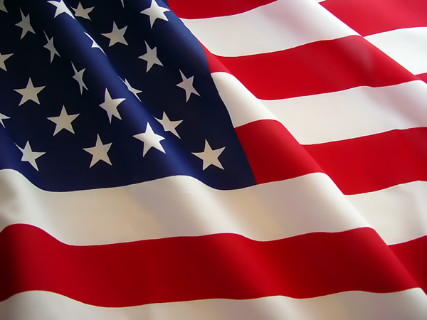
Conclusion
In conclusion, the journey to the government we have today has been a long and tedious. After a failed government in the past and problems that needed to be fixed, the five Founding Fathers congregated together to make the country unified and powerful. The government they created has remained unbreakable throughout two centuries and, unlike many countries in the past, has nearly kept the same principles since the Constitution was first drafted. This document has stood true to its meaning and through the test of time.
(American flag, 2008)

Slide 16
References
American Flag. Retrieved March 7, 2008, Web site: http://aast.wordpress.com/2007/07/04/asian-americans-in-the-us-military/
American Flag 2. Retrieved March 11, 2008, Web site: http://www.photohome.com/photos/flag-pictures/american-flag-2.html
Closets. Retrieved March 11, 2008, Web site:
http://www.minnesotamonthly.com/media/Minnesota-Monthly/Guides-Resources/Trendsetters/Twin-Cities-Closets-Co/
Closets 2. Retrieved March 11, 2008, Web site: http://first-glass-inc.com/en_closets.html
Colonies. Retrieved March 11, 2008, Web site: http://www.earlyamerica.com/earlyamerica/maps/english_colonies/
Constitution. Retrieved March 7, 2008, Web site:
http://www.regent.edu/general/library/about_the_library/news_publications/2007_08.cfm
Constitution 2. Retrieved March 7, 2008, Web site:
http://www.jupiterimages.com/popup2.aspx?navigationSubType=itemdetails&itemID=22183616
Continental Congress. Retrieved March 8, 2008, Web site: http://www.nationmaster.com/encyclopedia/John-Adams
Crihfield, Sandra. (2008) Public Lectures. Lectures at Sarasota High School January 2008, February 2008, March 2008
Crumpled Paper. Retrieved March 11, 2008, Web site: http://www.bioinformaticszen.com/tag/charts/
Different Shapes. Retrieved March 8, 2008, from http://www.qtoys.com.au/homeshow.php?cid=6

Slide 17
Geroge Washington. Retrieved March 11, 2008, Web site: http://www.solarnavigator.net/history/george_washington.htm
Government. Retrieved March 7, 2008, Web site: http://www.cpdulles.com/government.htm
Government 2. Retrieved March 7, 2008, Web site: http://www.nationwideshelving.com/past_projects/government.php
Handshake. Retrieved March 11, 2008, Web site: http://www.brandywinepool.com/
King George III. (2008). In Wikipedia: The Free Encyclopedia [Web]. Retrieved March 8, 2008, from
http://en.wikipedia.org/wiki/King_George_III
Magruder, M (2004). American Government. Upper Saddle River, New Jersey: Pearson Prentice Hall.
Maze. Retrieved March 10, 2008, Web site: http://www.mobot.org/hort/tours/victtour.shtml
Maze 2 . Retrieved March 10, 2008, Web site: http://duramecho.com/Art/RainbowLabyrinths/Mazes/index.html
Pile Puzzle Pieces. Retrieved March 10, 2008, Web site: http://dexdex.blogspot.com/2007/04/putting-right-pieces-together.html
Scissors. Retrieved March 8, 2008, Web site:
http://www.jupiterimages.com/popup2.aspx?navigationSubType=itemdetails&itemID=22845116
Scissors 2. Retrieved March 8, 2008, Web site: http://www.fotosearch.com/DGT557/42-17485148/
Second Continental Congress. In Wikipedia: The Free Encyclopedia [Web]. Retrieved March 8, 2008 , from
http://en.wikipedia.org/wiki/Second_Continental_Congress

Slide 18
Second Continental Congress. Retrieved March 8, 2008, Web site:
http://encarta.msn.com/media_461516718/second_continental_congress.html
Shay's Rebellion. Retrieved March 10, 2008, Web site: http://www.constitutioncenter.org/timeline/html/cw02_11926.html
Staircase. Retrieved March 11, 2008, Web site:
http://www.russiablog.org/2007/02/walking_through_st_petersburg_2.php
Staircase 2. Retrieved March 11, 2008, Web site:
http://www.supplierlist.com/made_in_china/products/p0/Vision_System/40595_manufacturers.htm
Trash Can. Retrieved March 11, 2008, Web site: http://whateves.com/2007/10/18/lucas-to-dittle-ur-skittle-one-more-time/
United States Constitution. (2008). In Wikipedia: The Free Encyclopedia [Web]. Retrieved March 7, 2008 , from
http://en.wikipedia.org/wiki/United_states_constitution
Washington D.C.. Retrieved March 10, 2008, Web site: http://www.cpdulles.com/washington_dc.htm
Wilson, J, & Dilulio, Jr. , J (2004). American Government.Boston, Massachusetts: Houghton Mifflin Company.

